Slide 1
Turbine Casing – Thermal Analysis_Methane vs Hydrogen
Ing. Jacopo Fumanti Petrini
Software used: Siemens NX Simcenter | Ansys 2025 R1
The turbine casing should be considered as a scale model

Slide 2
Objective
The objective of this study is to evaluate and compare the steady-state thermal behavior of a turbine casing subjected to methane and hydrogen combustion conditions. The analysis aims to assess the thermal load distribution and its potential impact on the structural integrity of the casing.

Slide 3
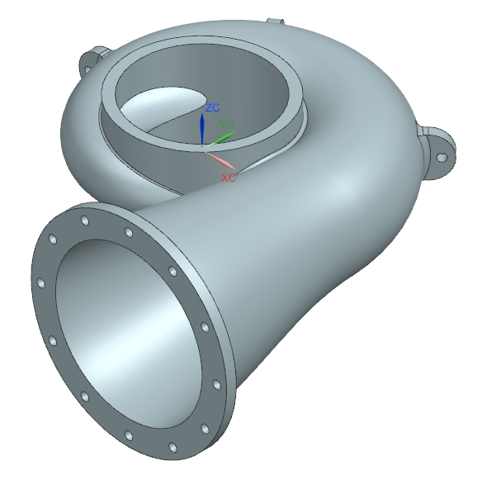
Setup Overview
Geometry modeled in Siemens NX and imported into ANSYS Fluent
Steady-state thermal analysis performed under two boundary conditions:
Case A: Methane – High heat flux and lower convective cooling
Case B: Hydrogen – Enhanced convection, lower overall heat flux
Material: AISI 310S Stainless Steel
Reference temperature range: 800°C – 1900°C

Slide 4
Results – Methane Case
Maximum Temperature: 1415°C
Minimum Temperature: 808°C
Heat distribution is uniform along the casing with localized hot zones near the outlet region.
The temperature remains below the critical limit of AISI 310S, ensuring structural integrity.

Slide 5
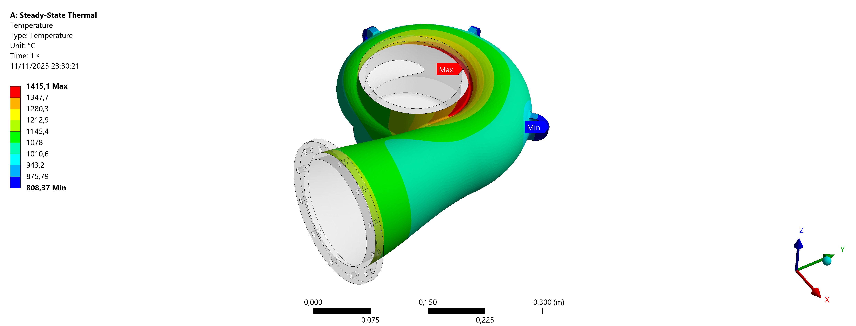
Results – Methane Case
CFD analysis shows the air velocity distribution within the turbine casing.
The flow enters tangentially, accelerating along the spiral path, with a peak velocity of 30.6 m/s.

Slide 6
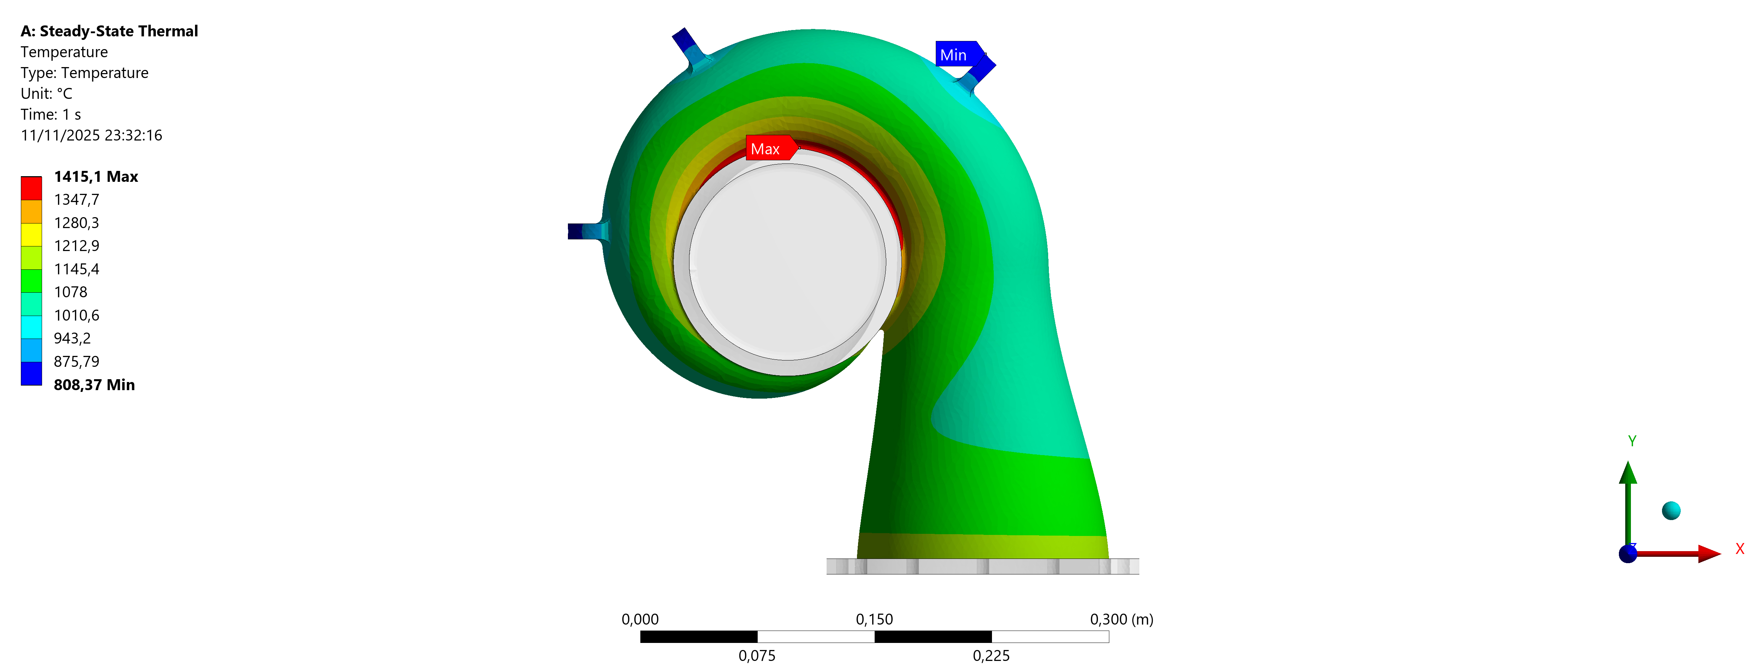
Results – Methane Case
CFD analysis shows the air velocity distribution within the turbine casing.
The flow enters tangentially, accelerating along the spiral path, with a peak velocity of 30.6 m/s.

Slide 7
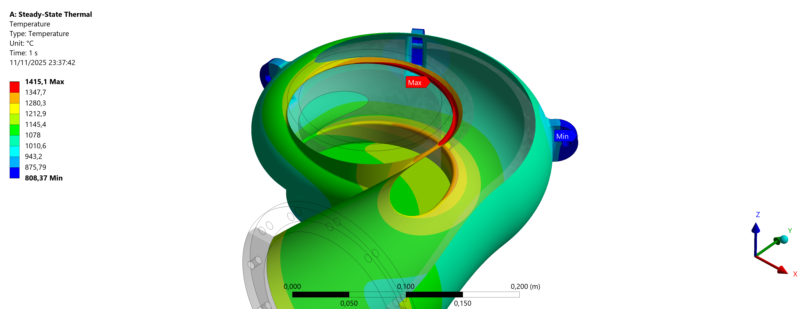
Results – Methane Case
CFD analysis shows the air velocity distribution within the turbine casing.
The flow enters tangentially, accelerating along the spiral path, with a peak velocity of 30.6 m/s.

Slide 8
Results – Hydrogen Case
Maximum Temperature: 1873°C
Minimum Temperature: 1007°C
The casing experiences higher thermal gradients due to the higher flame temperature of hydrogen.
Peak temperature exceeds the safe operating limit for AISI 310S, indicating potential structural degradation.

Slide 9
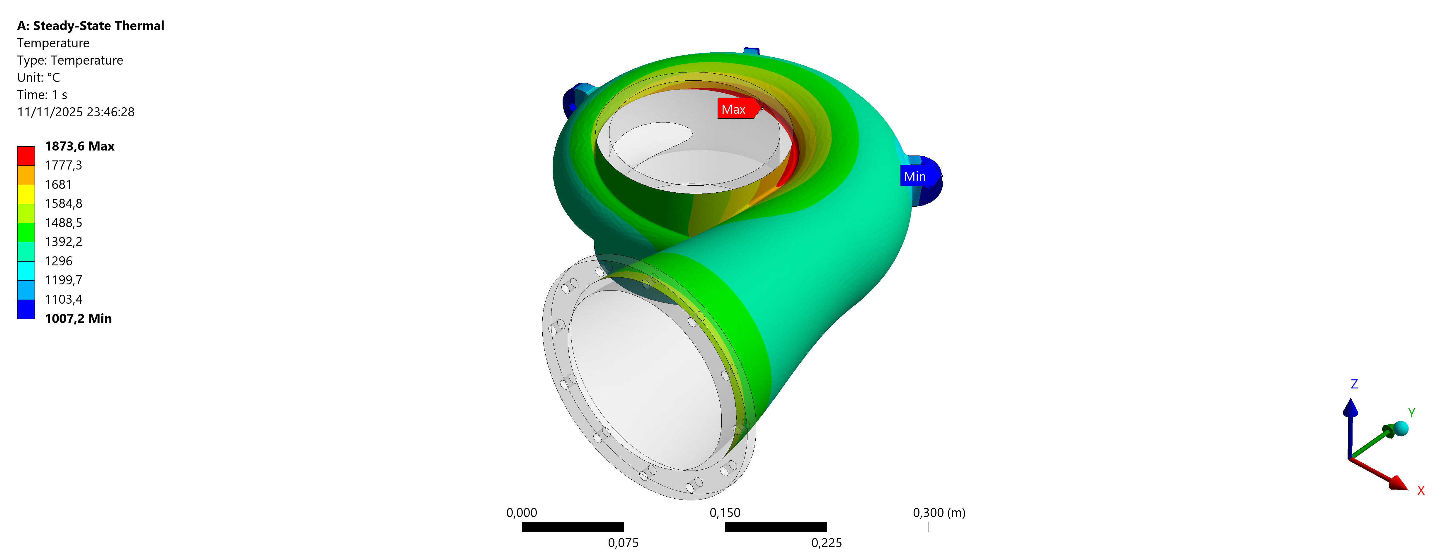
Results – Hydrogen Case
CFD analysis shows the air velocity distribution within the turbine casing.
The flow enters tangentially, accelerating along the spiral path, with a peak velocity of 30.6 m/s.

Slide 10
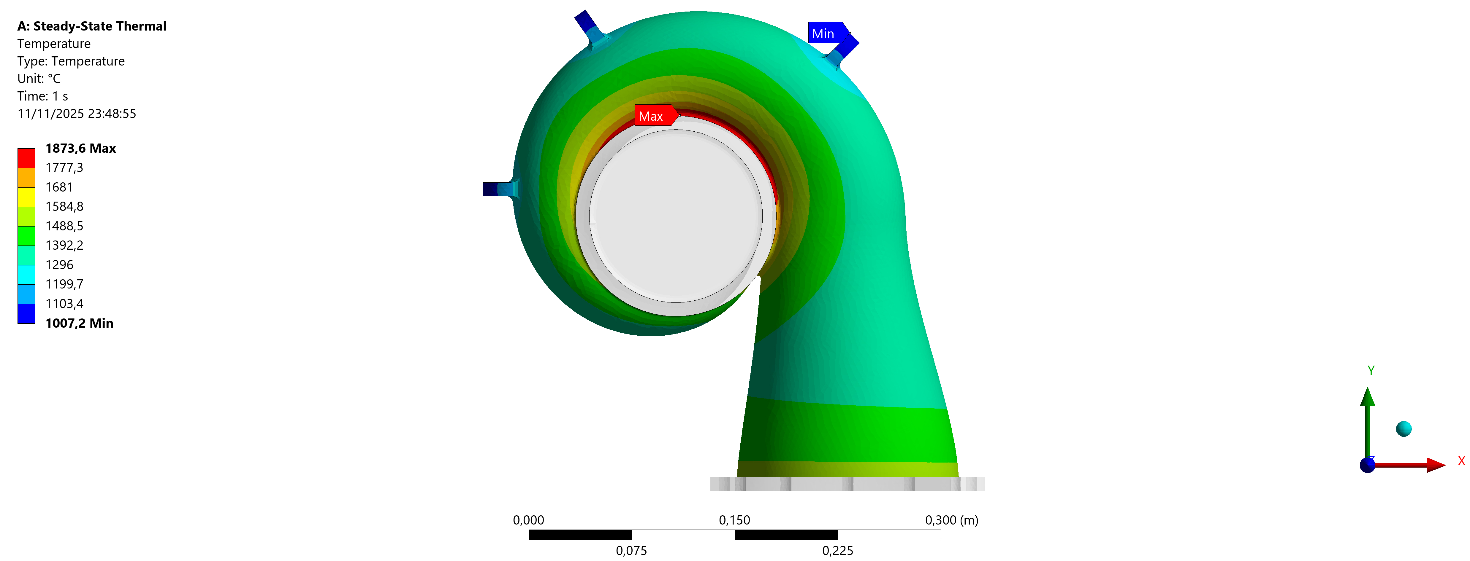
Results – Hydrogen Case
CFD analysis shows the air velocity distribution within the turbine casing.
The flow enters tangentially, accelerating along the spiral path, with a peak velocity of 30.6 m/s.
CFD analysis shows the air velocity distribution within the turbine casing.
The flow enters tangentially, accelerating along the spiral path, with a peak velocity of 30.6 m/s.

Slide 11
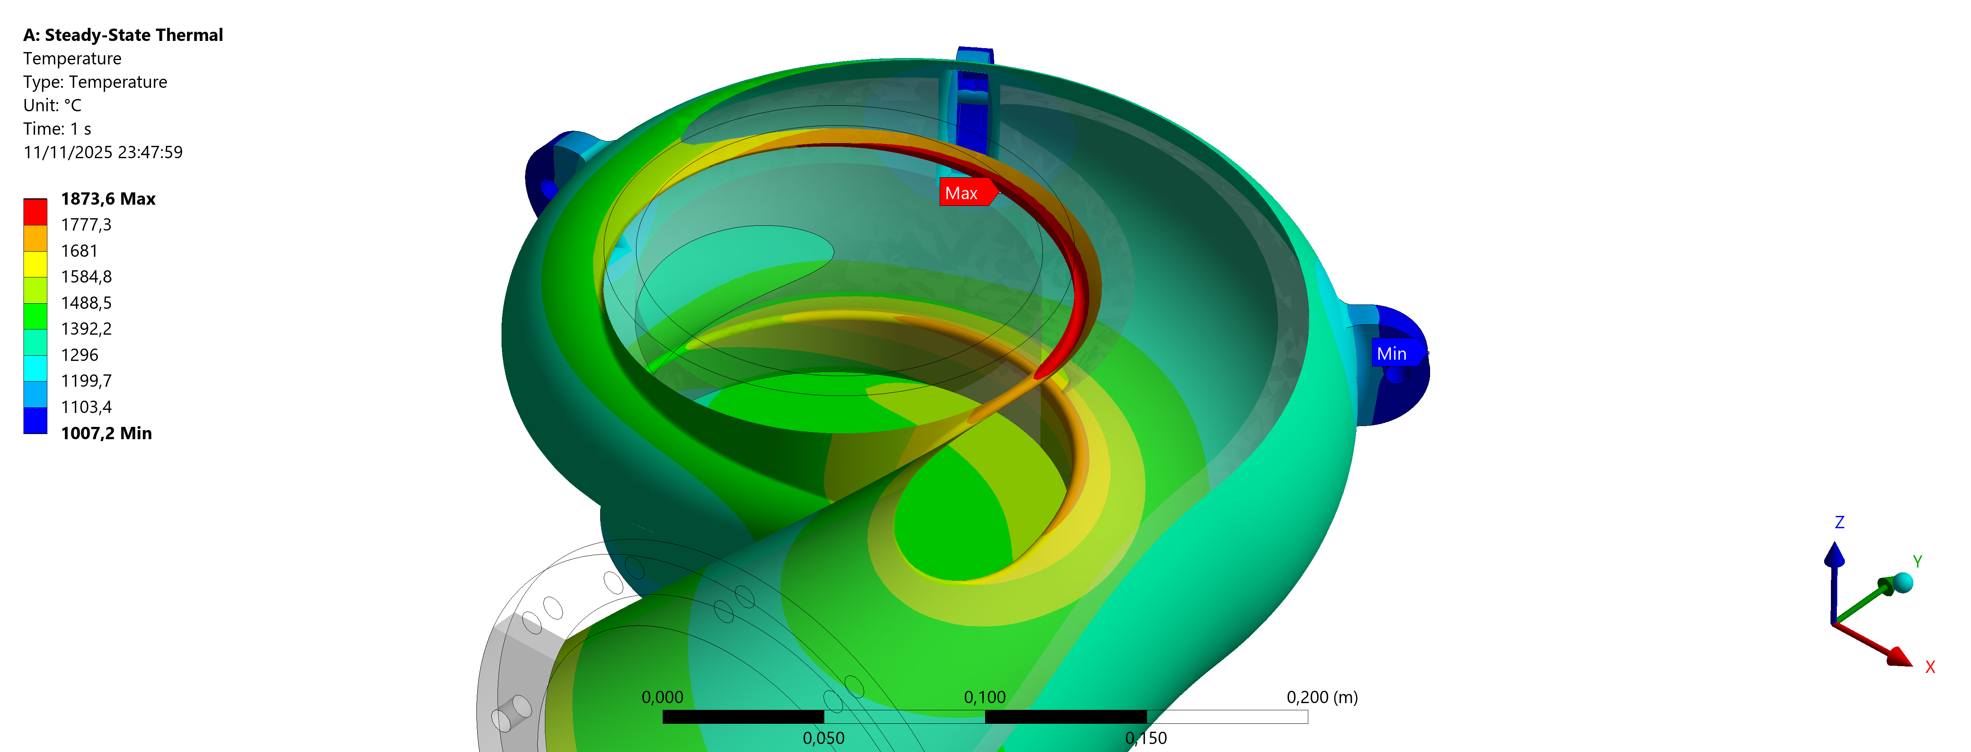
Results – Hydrogen Case
CFD analysis shows the air velocity distribution within the turbine casing.
The flow enters tangentially, accelerating along the spiral path, with a peak velocity of 30.6 m/s.
CFD analysis shows the air velocity distribution within the turbine casing.
The flow enters tangentially, accelerating along the spiral path, with a peak velocity of 30.6 m/s.

Slide 12
Comparison and discussion
The hydrogen case exhibits a 30% higher peak temperature compared to methane.
This is primarily due to hydrogen’s higher combustion temperature and reduced radiative heat transfer.
Methane combustion leads to more stable wall temperatures and lower thermal stress concentration.

Slide 13
Structural correlation
AISI 310S maintains good strength up to 1100°C.
Beyond this temperature, the material undergoes creep deformation and oxidation.
Hydrogen case conditions (≈1870°C) far exceed this limit, suggesting loss of mechanical integrity.
Methane case temperatures remain within acceptable limits for continuous operation.

Slide 14
Recommendations
Introduce internal or external cooling channels for better heat management.
Implement thermal barrier coatings (TBCs) in the high-temperature regions.
Consider nickel-based superalloys or composite materials for hydrogen combustion cases.
Optimize convective boundary surface area using ribbed or finned designs.

Slide 15
Conclusions
Hydrogen operation leads to higher efficiency but imposes greater thermal stress on turbine casings.
The use of advanced materials and enhanced cooling is essential to ensure structural reliability.
Future work: coupled thermo-structural analysis to evaluate stress and deformation fields.

